Slide 1
Your Name: Vanita Perumandla Course: ASP.NET MVC Date: March 8, 2024 Instructor: Louise Rennick

Slide 2
ASP.NET C#DEVELOPMENT -ECOMMERCE APPLICATION – Resort Booking
Vanita perumandla

Slide 3
OBJECTIVES
Creating a Web Application for Resort online Booking using ASP.NET Core Web App(Model-View-Controller).
This application will have home page which will display’s Resort villas
Admin Features:
Admin login for managing add villas
Interfaces for CRUD operations on create Villas
User Features:
User authentication and registration.
Pages for browsing Villas, Resort booking, and completing orders.
Booking:
Implement functionalities to manage booking, update , and calculate totals.
Checkout Process:
Secure checkout flow for users to confirm orders and input payment/shipping details.
Integration with payment gateways used Stripe for secure transactions.

Slide 4
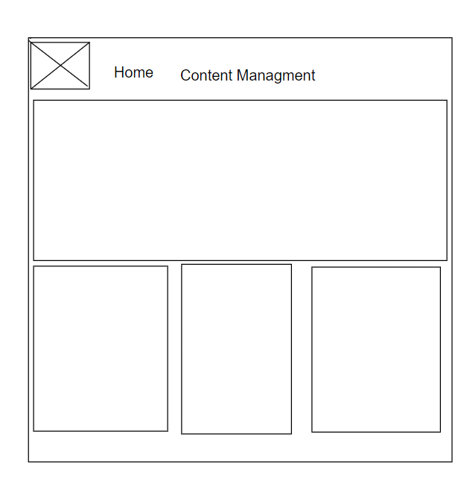
WIRE FRAME-User dashboard

Slide 5
WIRE FRAME-admin dashboard

Slide 6
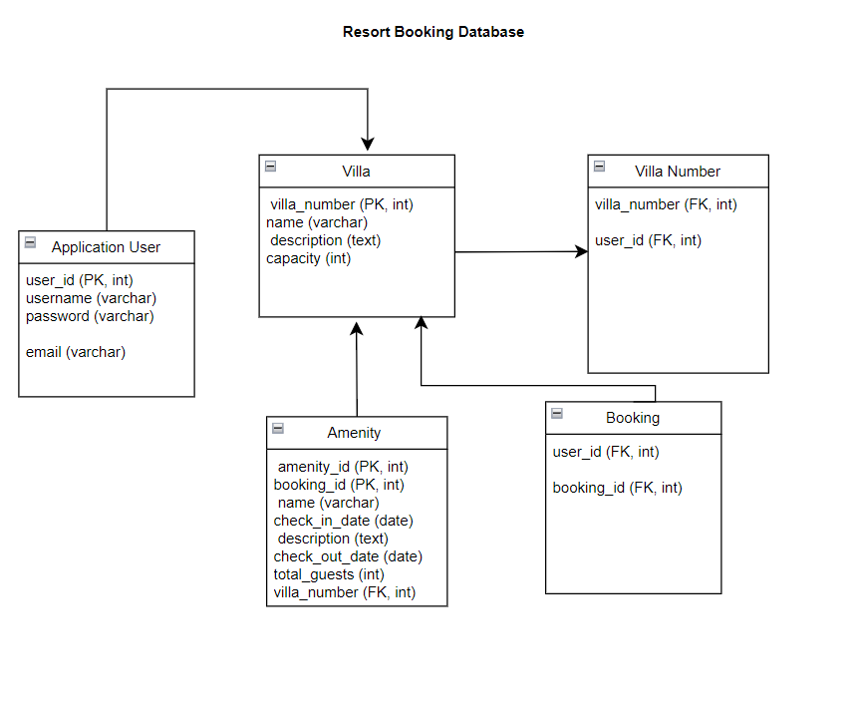
Resort Booking Database Diagram

Slide 7
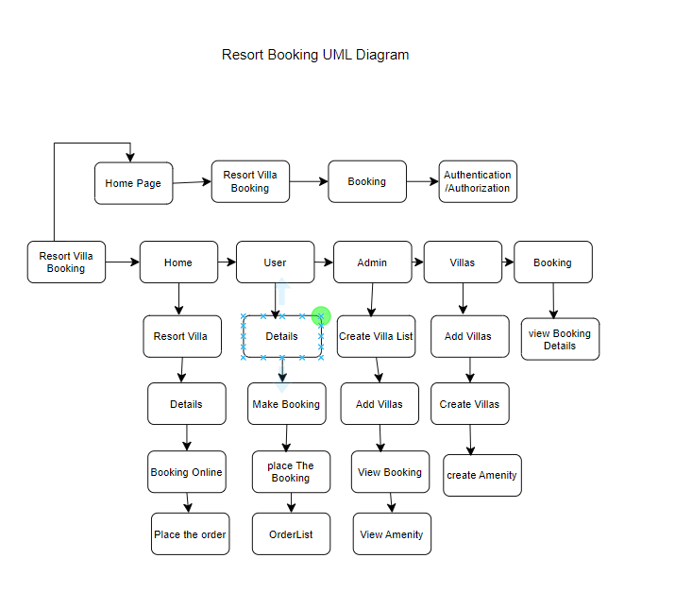
Resort Booking UML Diagram

Slide 8
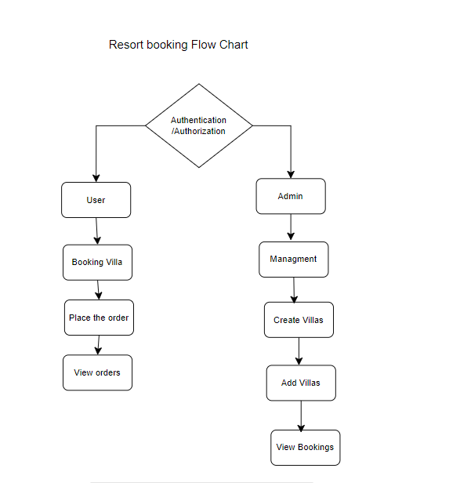
Resort Booking Flow Chart

Slide 9
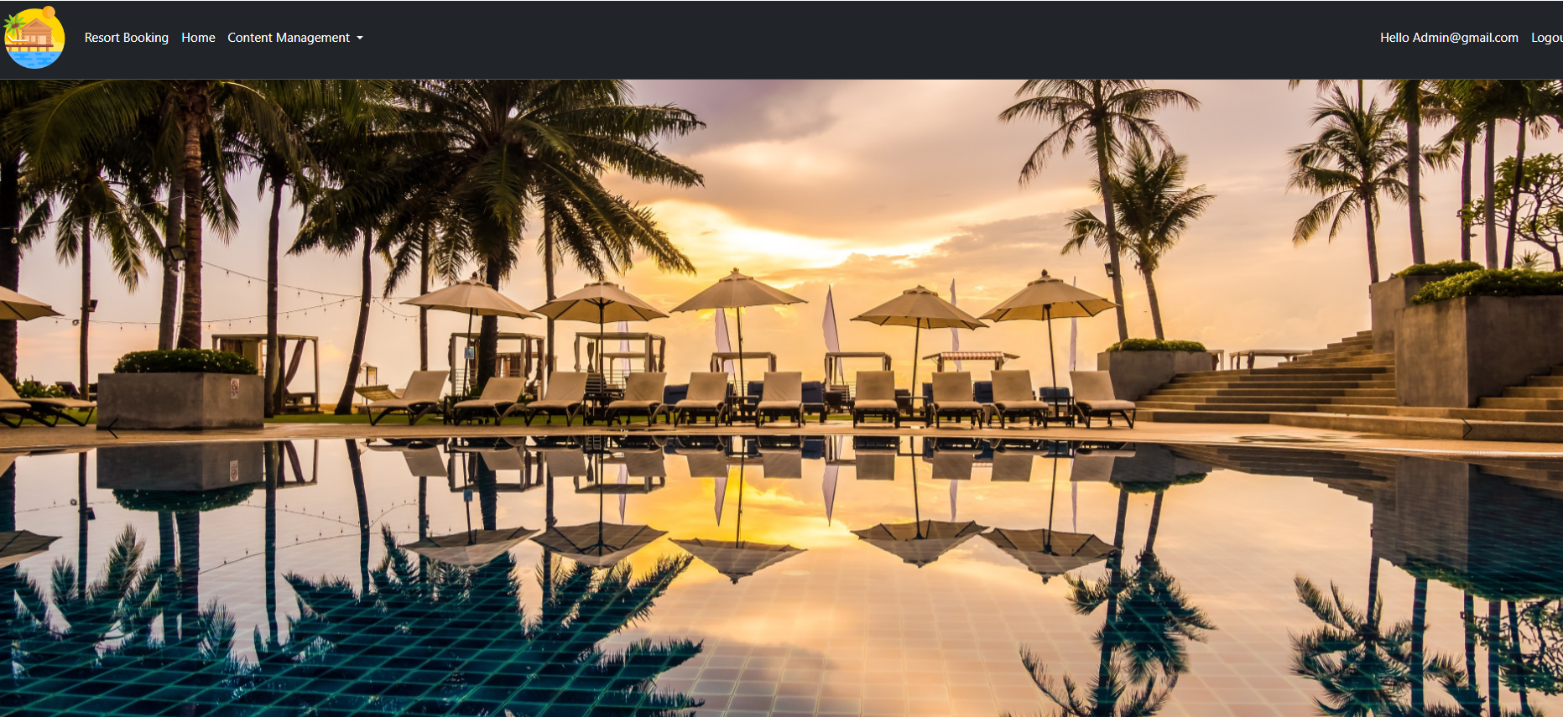
Resort Booking

Slide 10
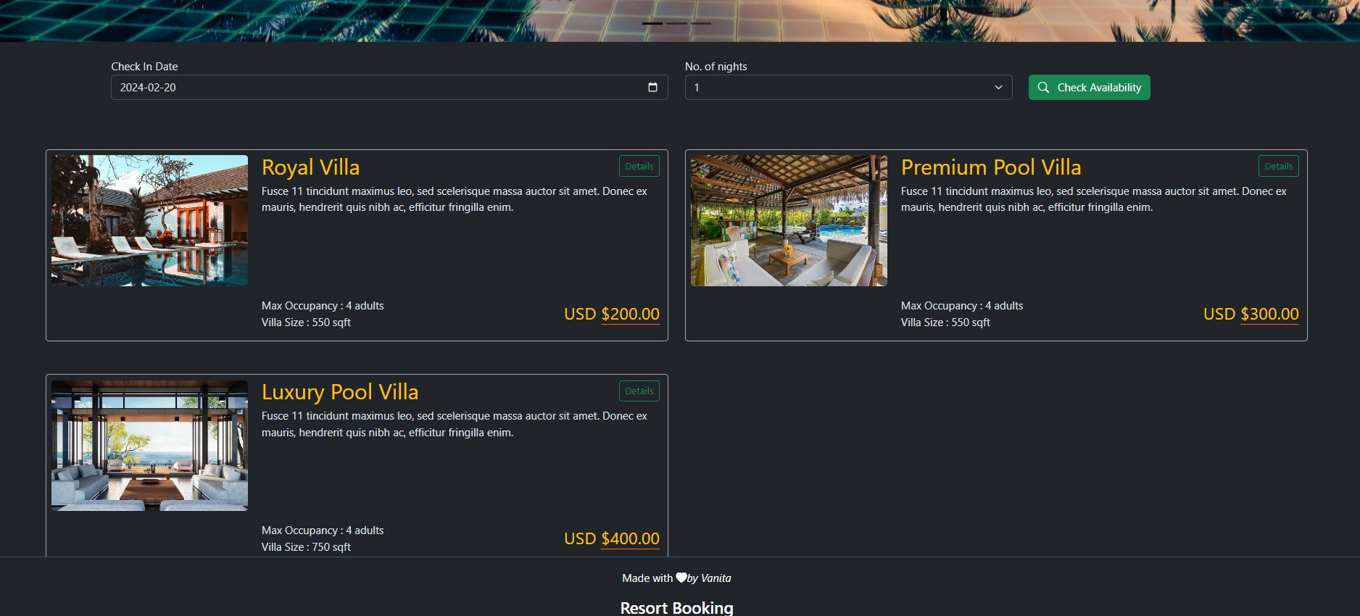
Resort Booking

Slide 11
New Items will be added in project
1. Slider image
2.Sppiner
3. Integrating Stripe as a payment gateway in the application
4.Add charts and graphs in the website
5.Admin Dashboard-side navbar

Slide 12
1. Slider image

Slide 13
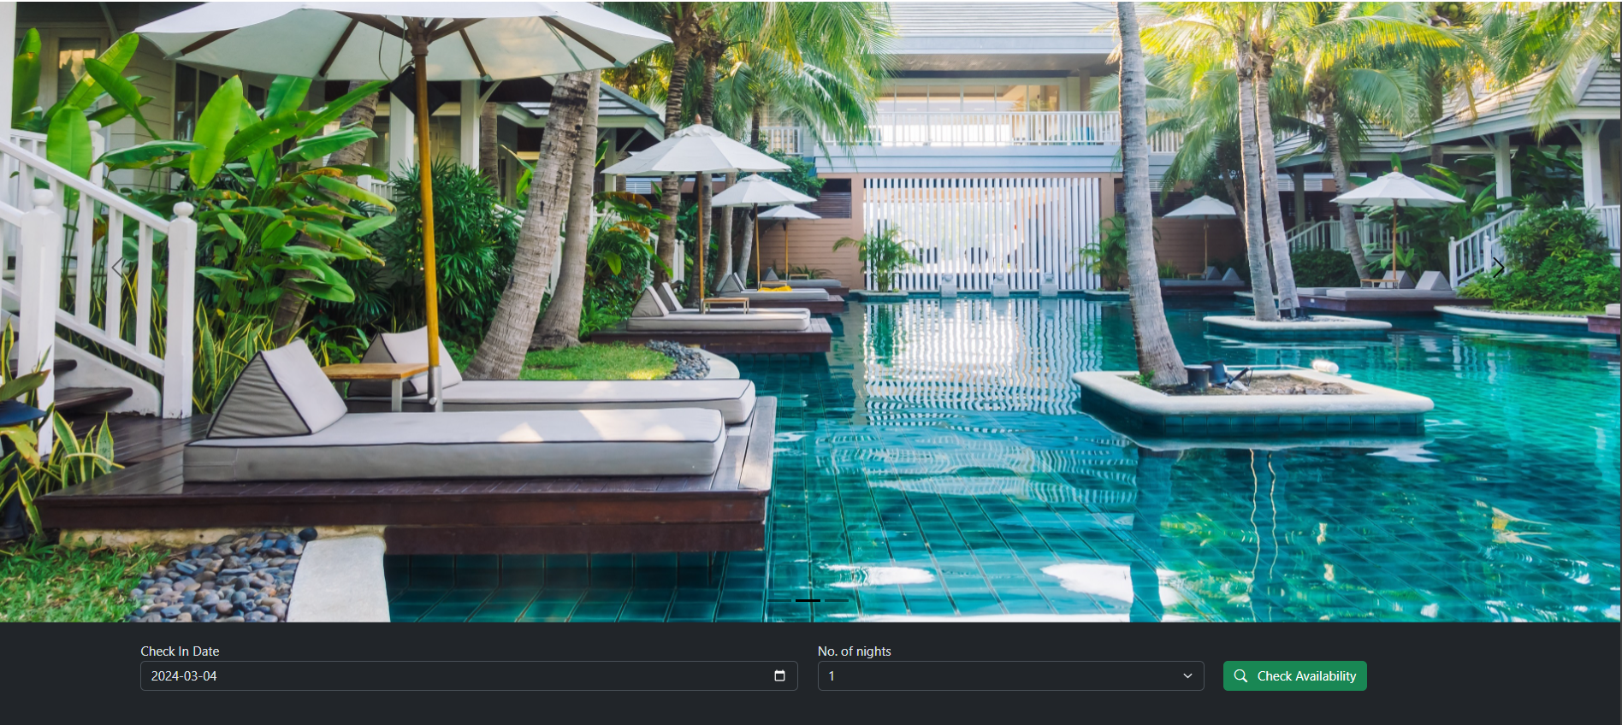
1. Slider image

Slide 14
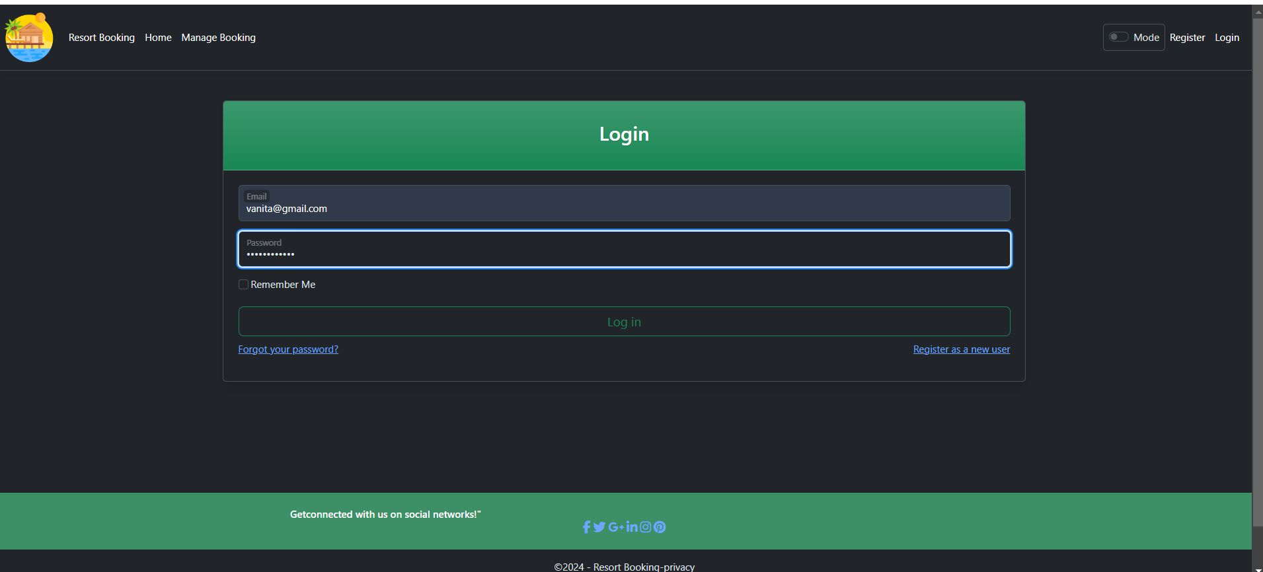
User Login

Slide 15
Home Page

Slide 16
Home Page

Slide 17
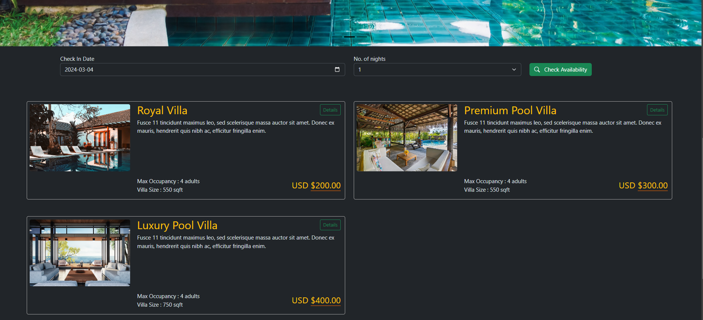
Check Villa Availability

Slide 18
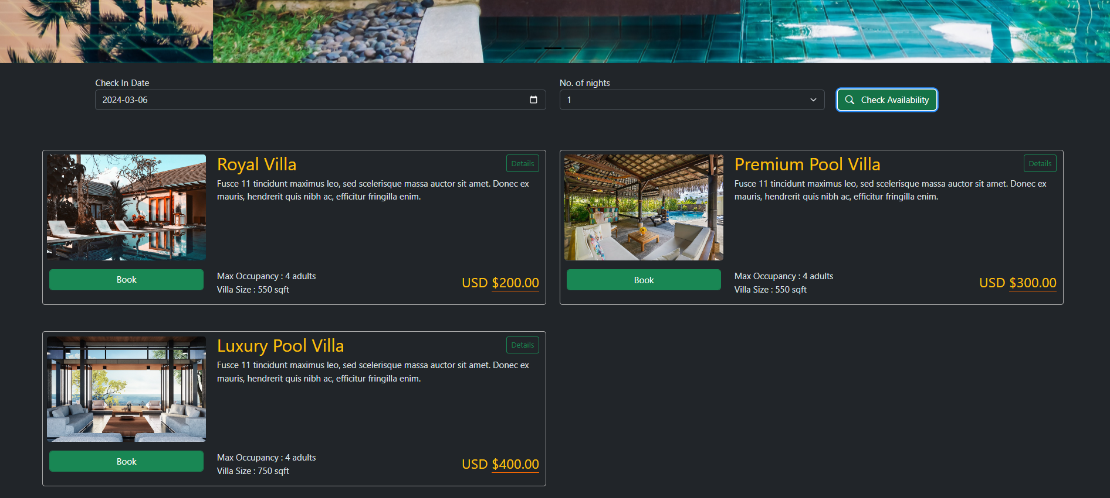
Booking Villa

Slide 19
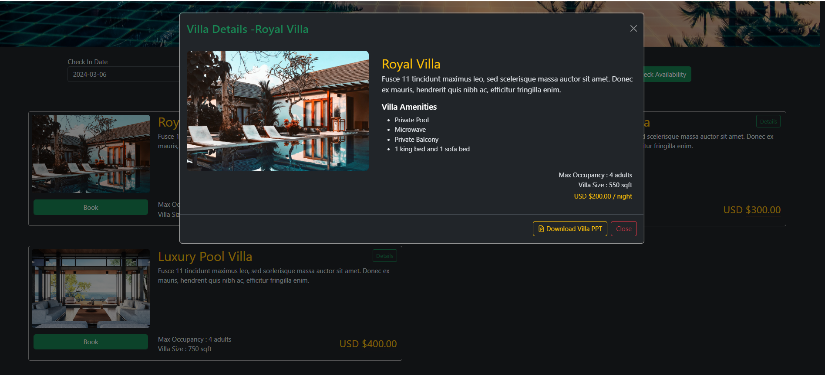
Booking Details

Slide 20
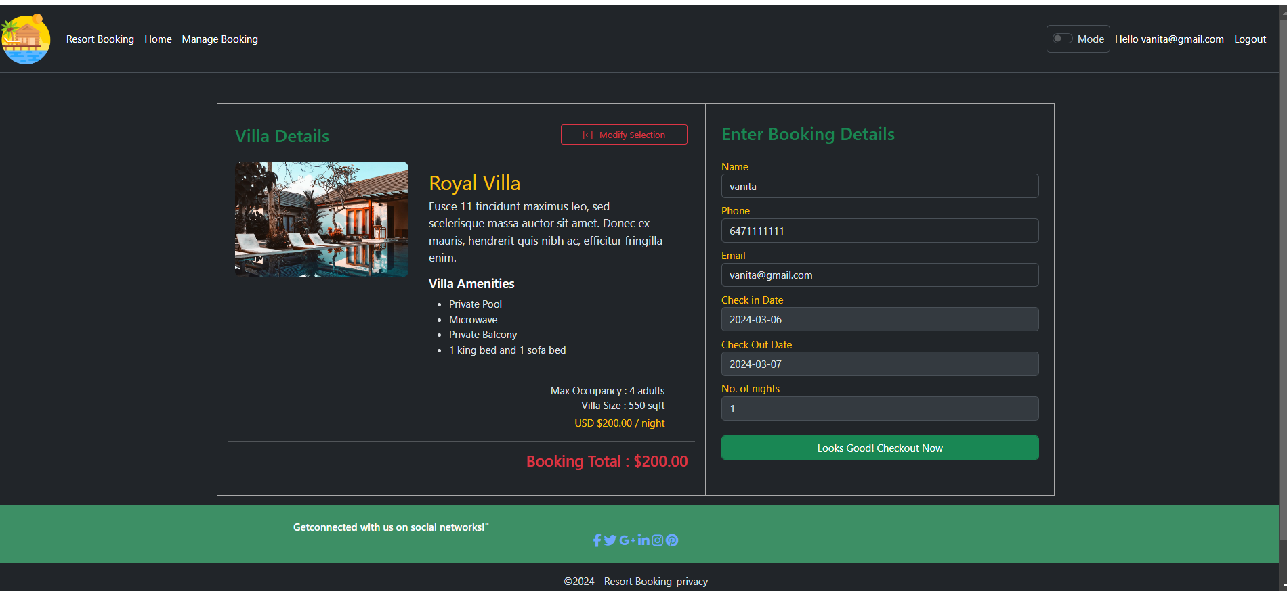
Booking Villa

Slide 21
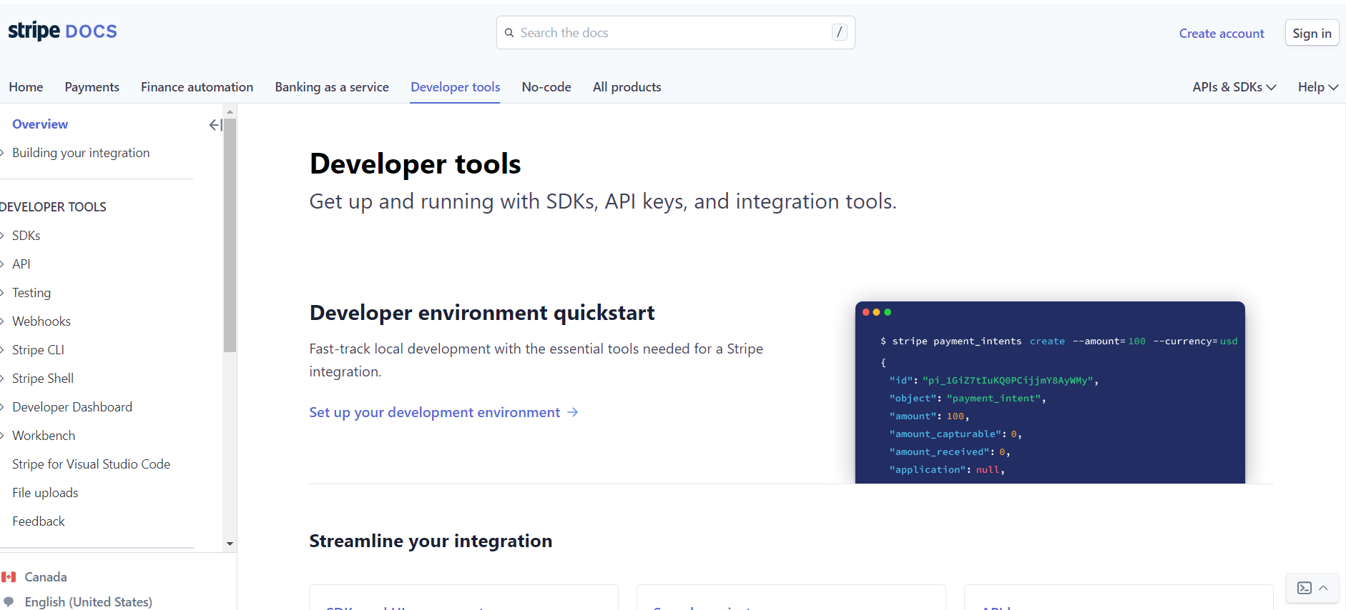
Create Stripe Account

Slide 22
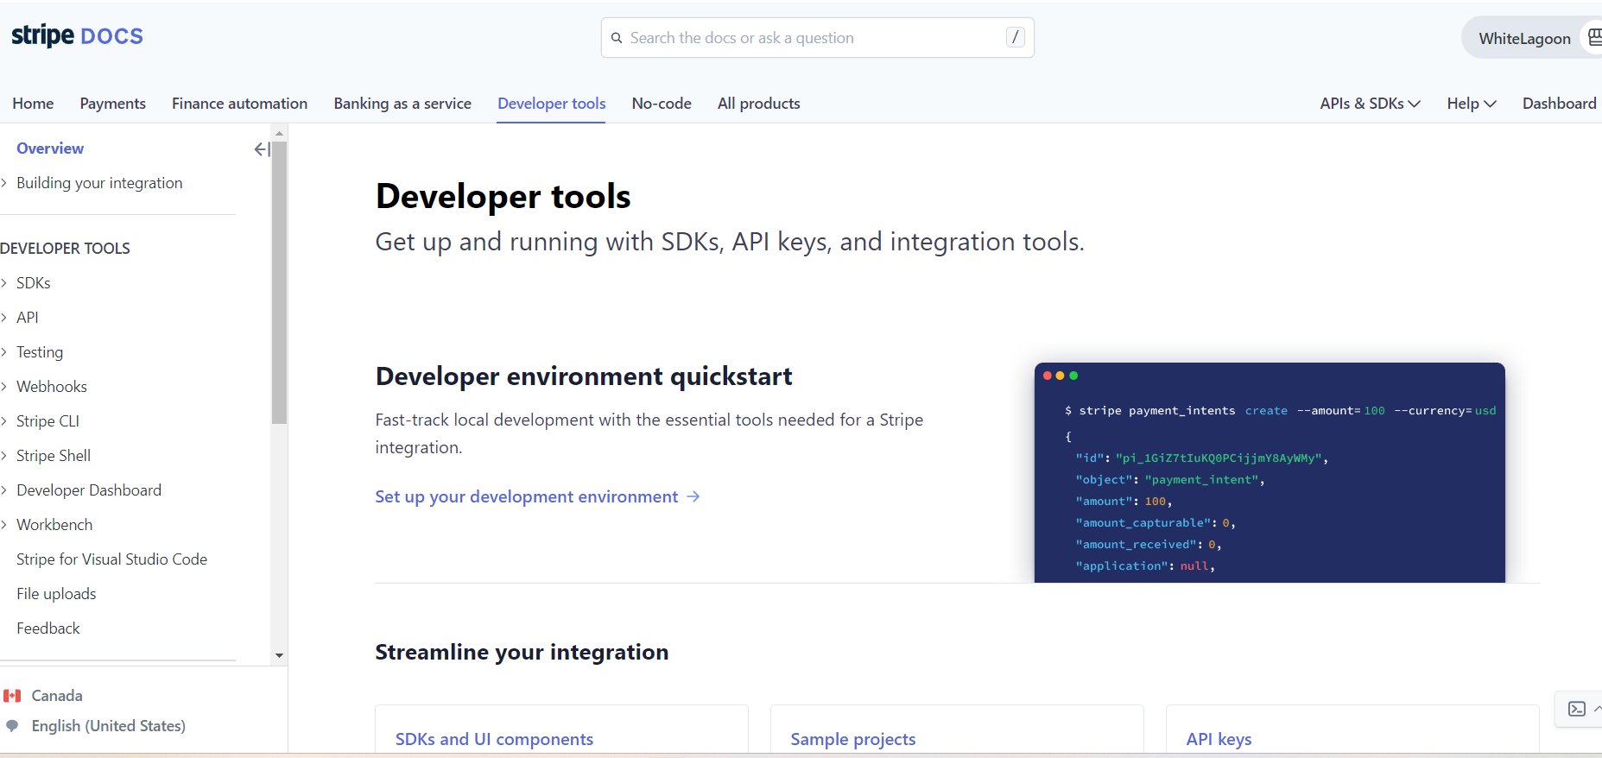
Create Stripe Account

Slide 23
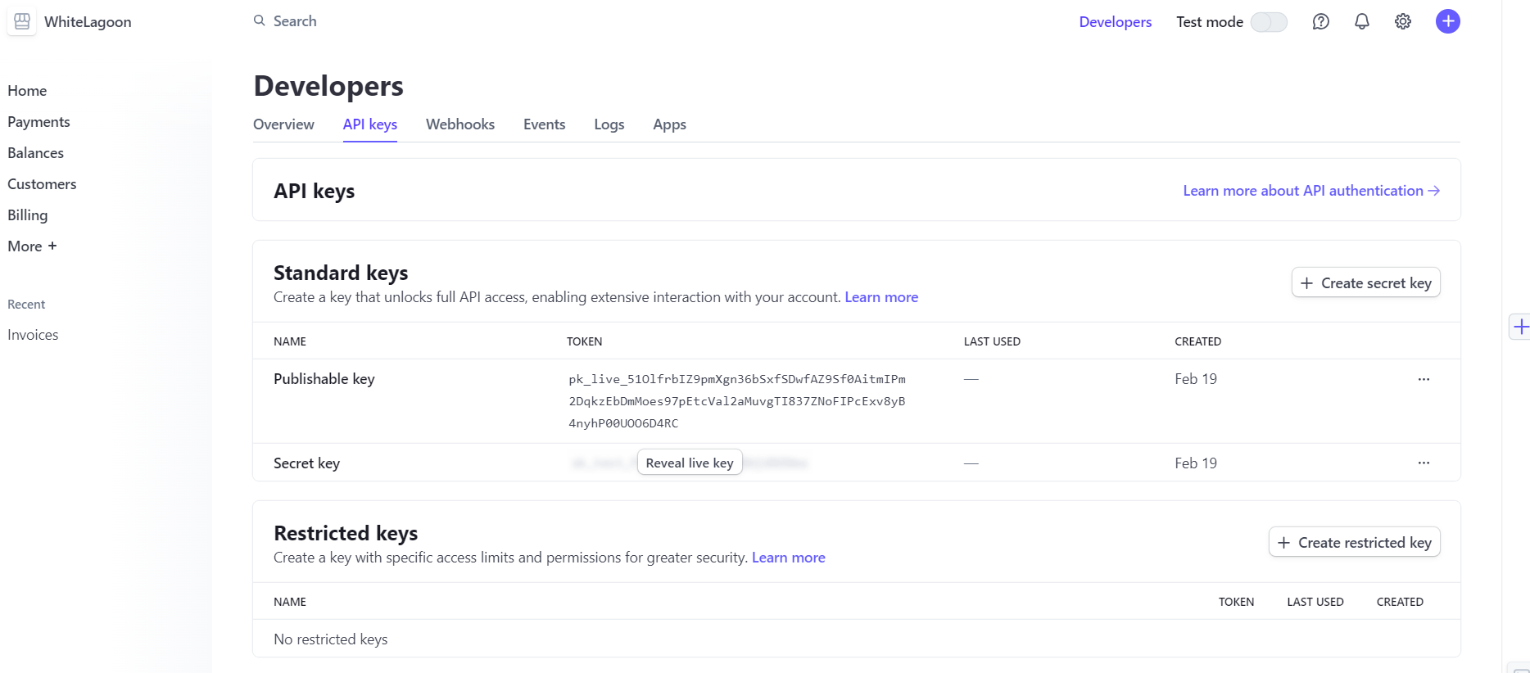
Create Stripe Account

Slide 24
Booking Villa

Slide 25
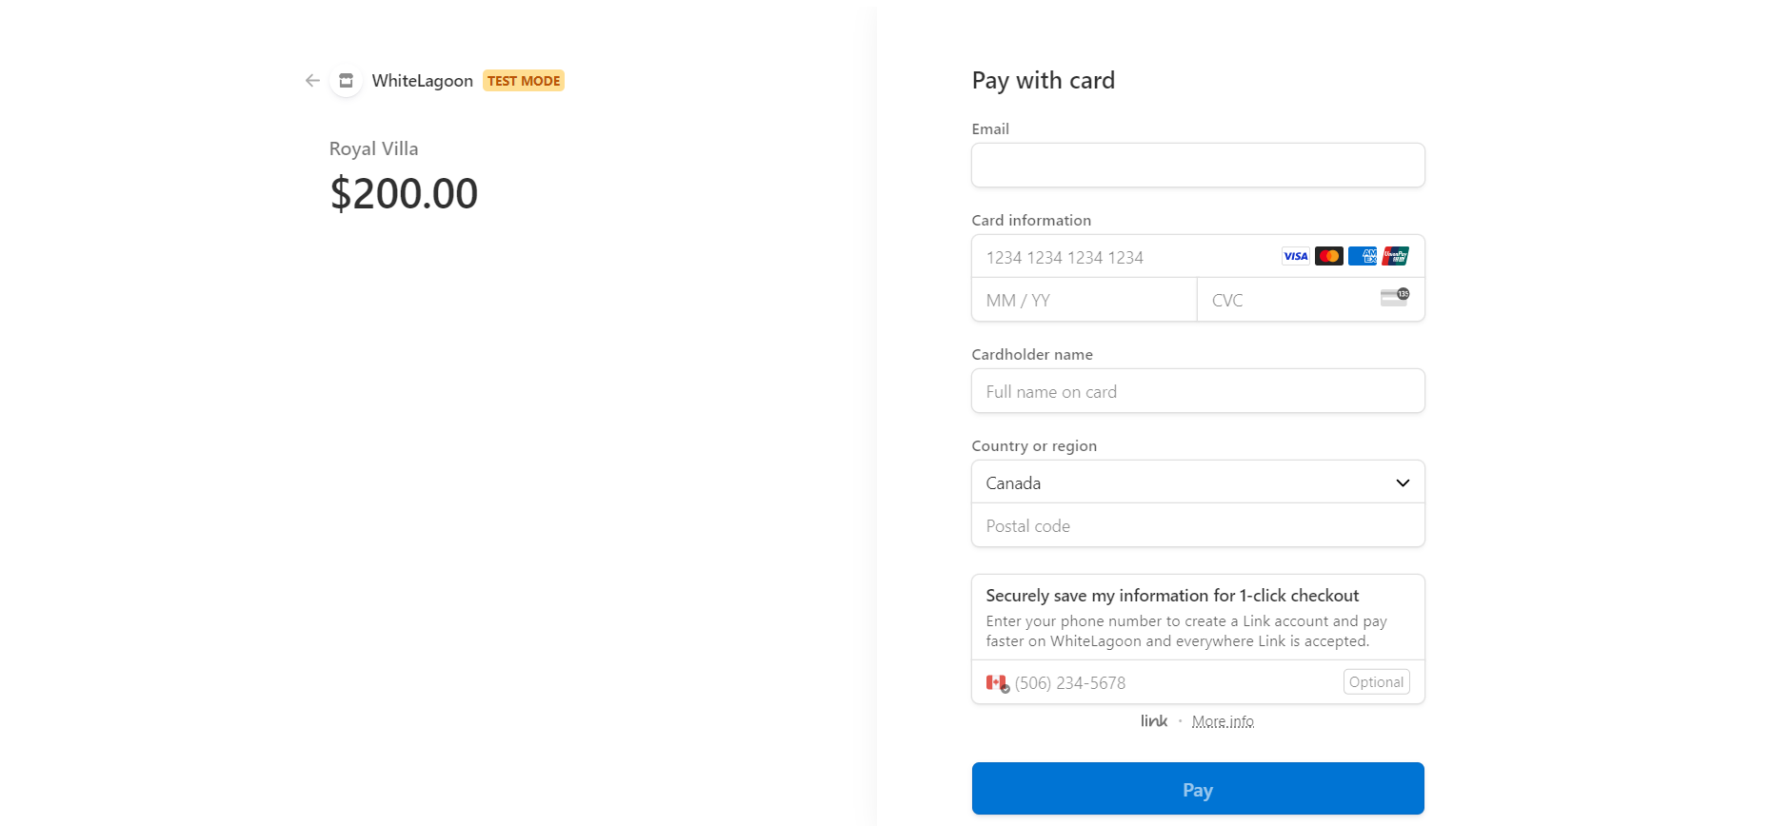
Use Stripe for payment gateway

Slide 26
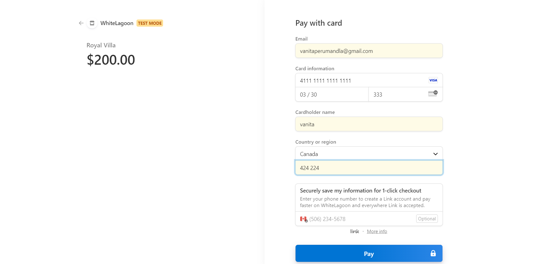
Use Stripe for payment

Slide 27
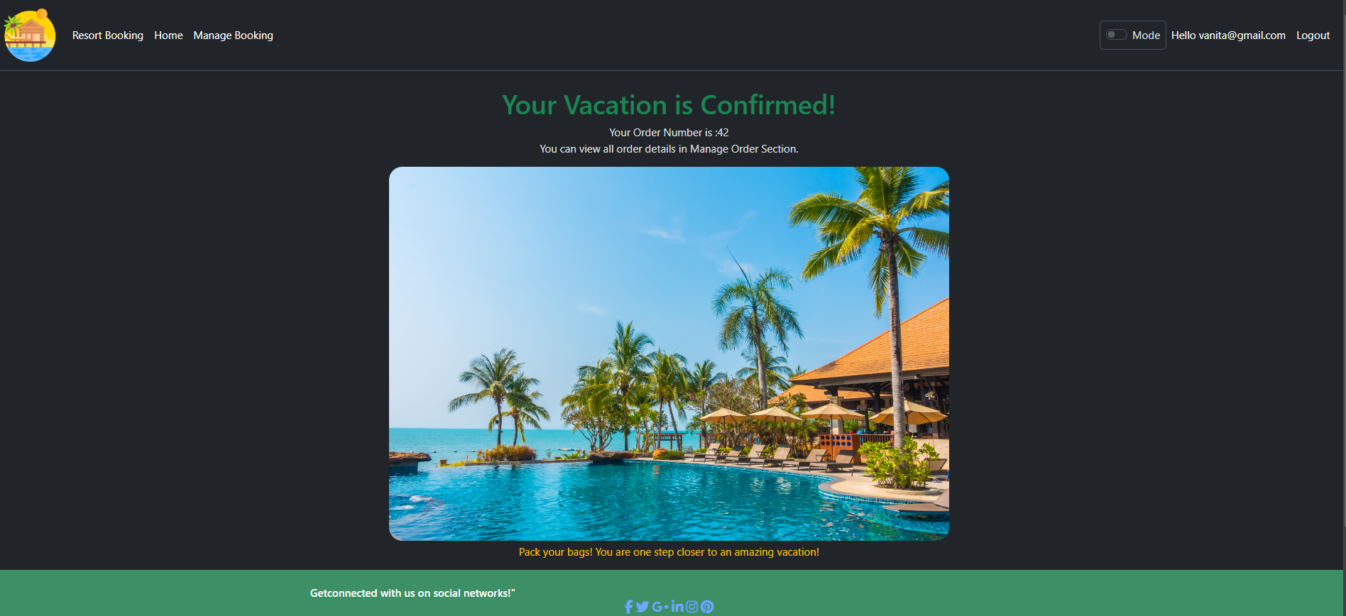
Complete payment Confirmation

Slide 28
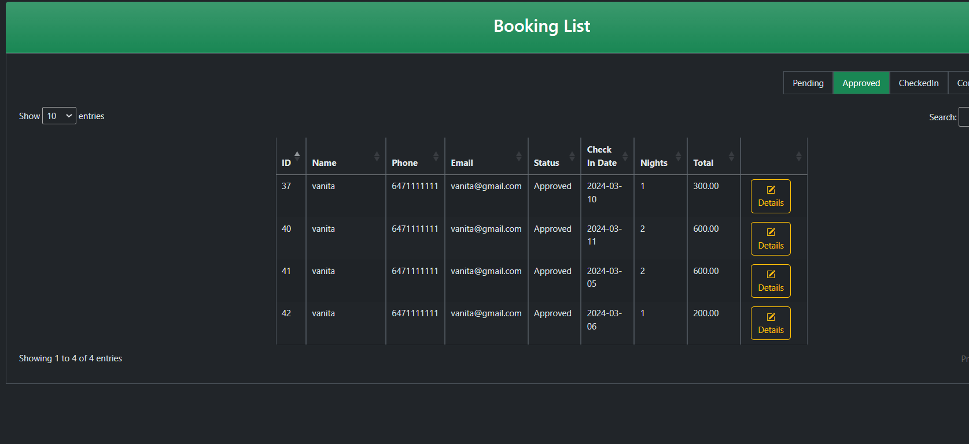
Manage Booking

Slide 29
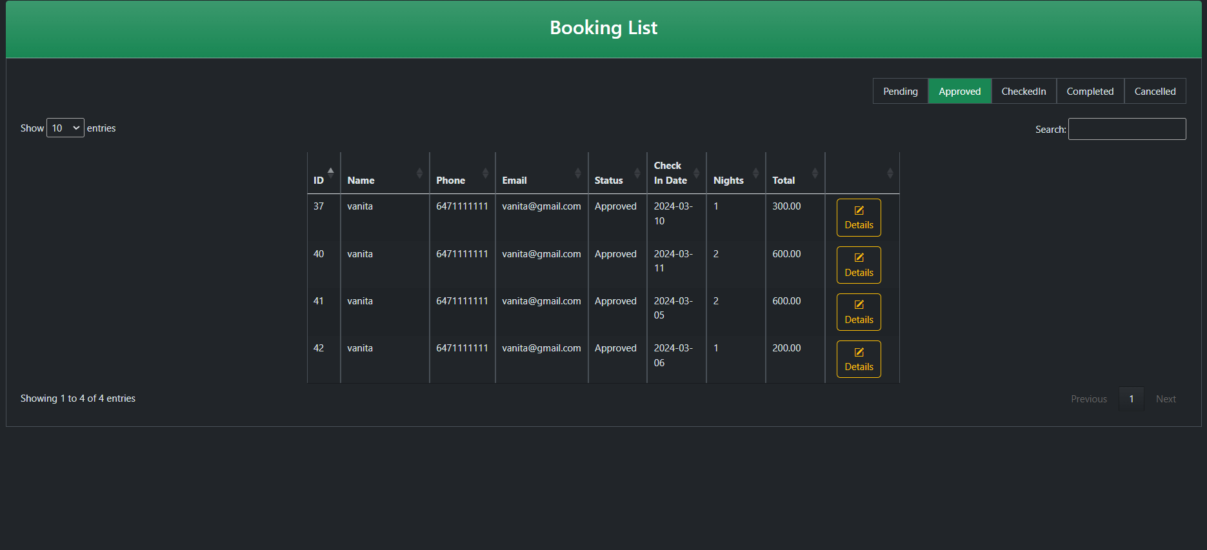
Manage Booking

Slide 30
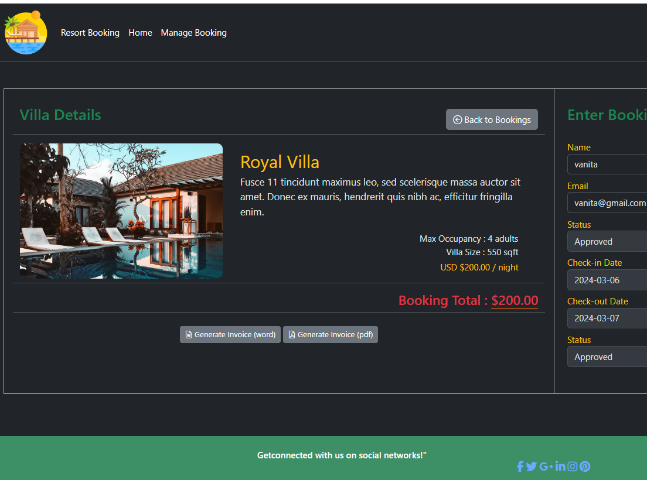
Generate Invoice (Word), Generate Invoice (pdf)

Slide 31
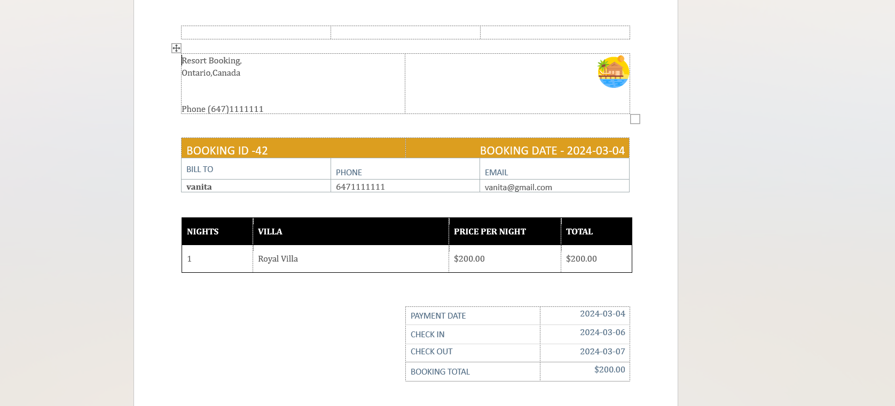
Generate Invoice (Word)

Slide 32
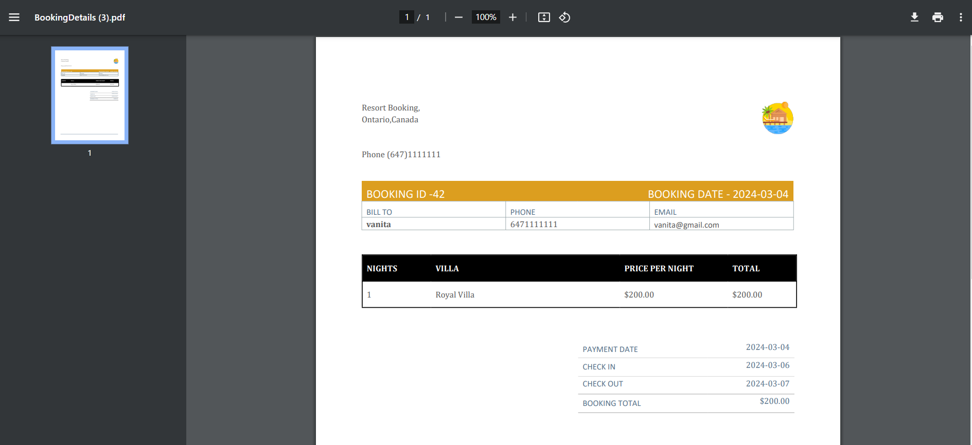
Generate Invoice

Slide 33
Generate Invoice (pdf)

Slide 34
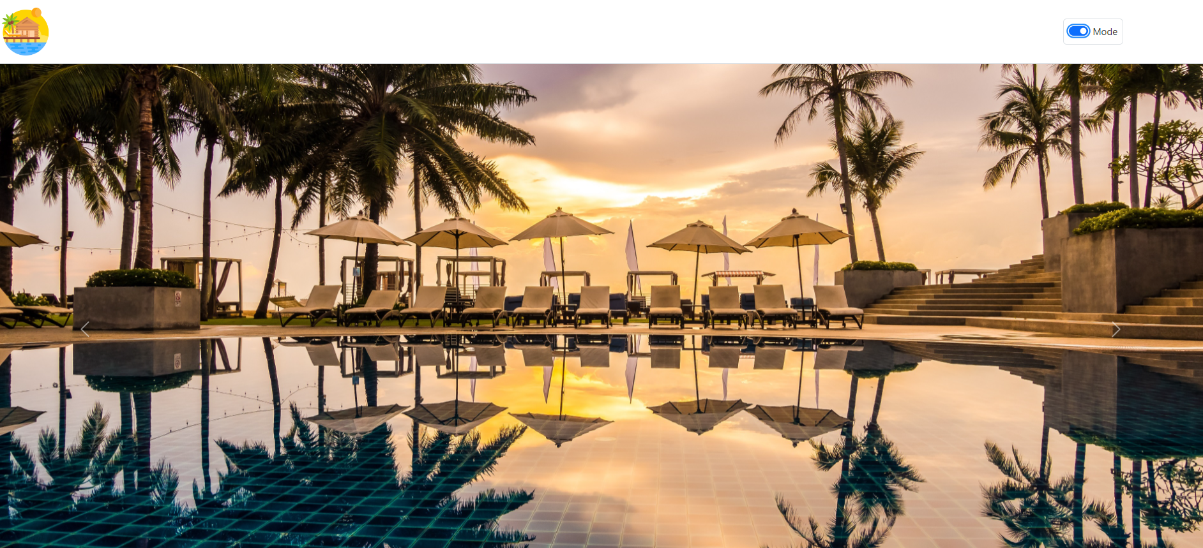
Light Mode

Slide 35
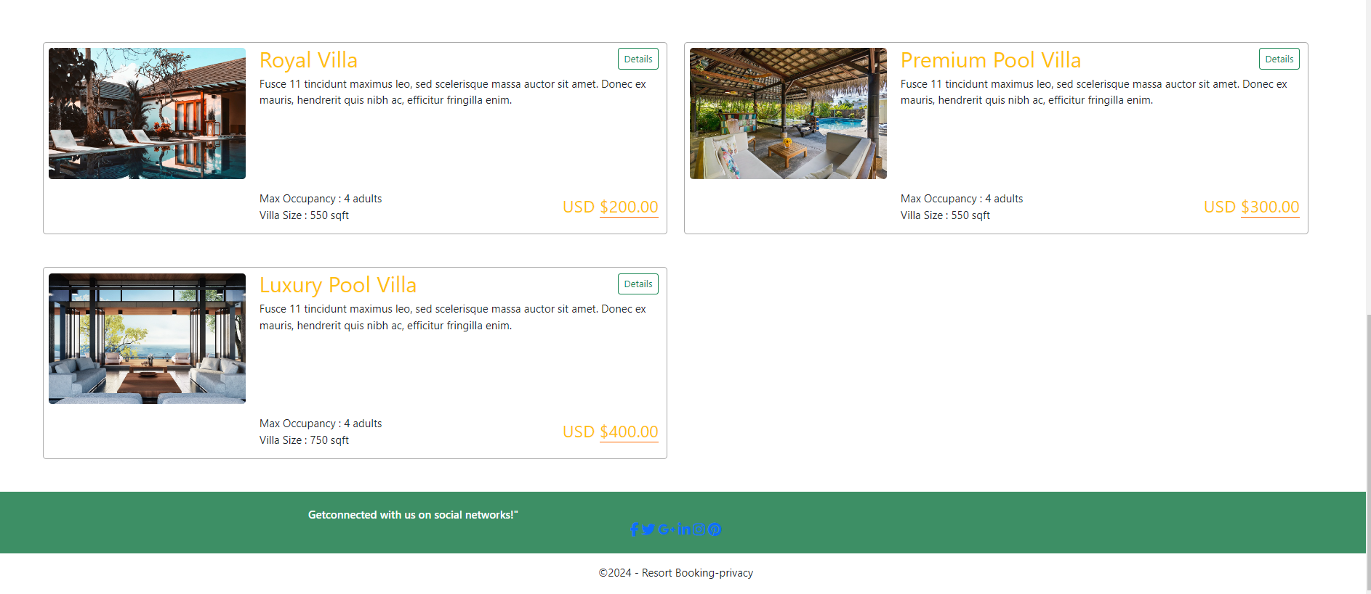
Light Mode

Slide 36
Dark Mode

Slide 37
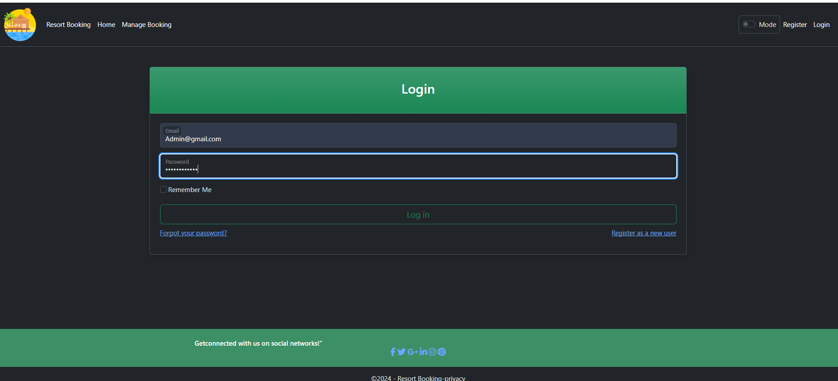
Login With Admin Credential

Slide 38
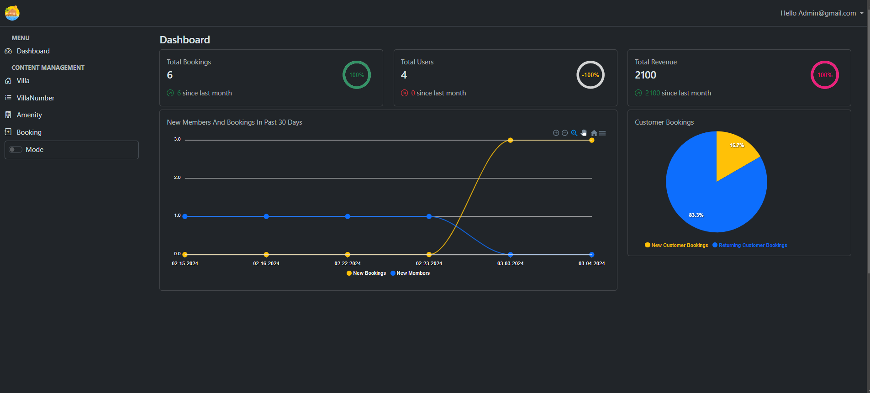
Admin Dashboard

Slide 39
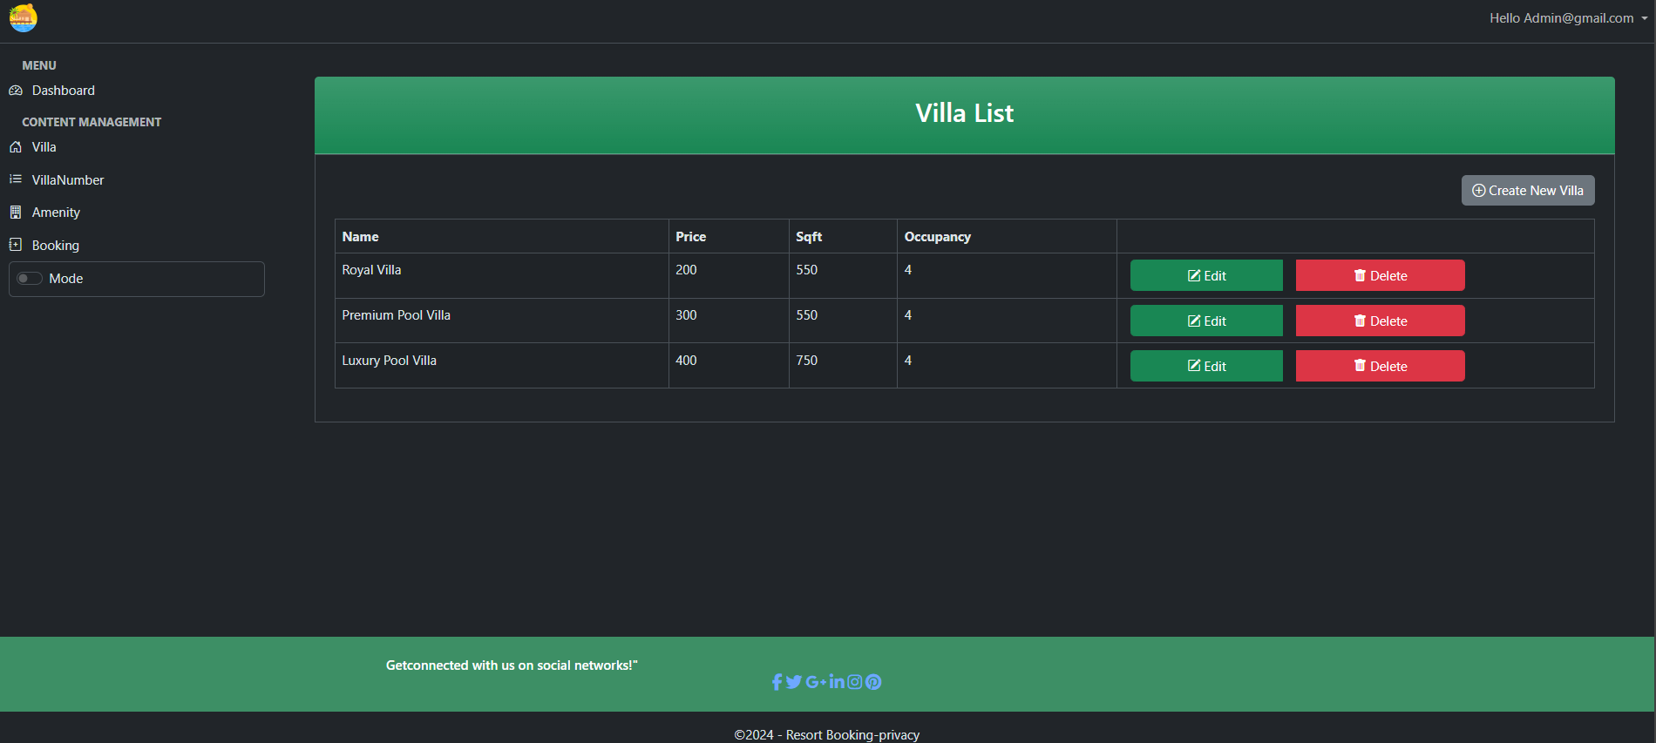
Create New Villa

Slide 40
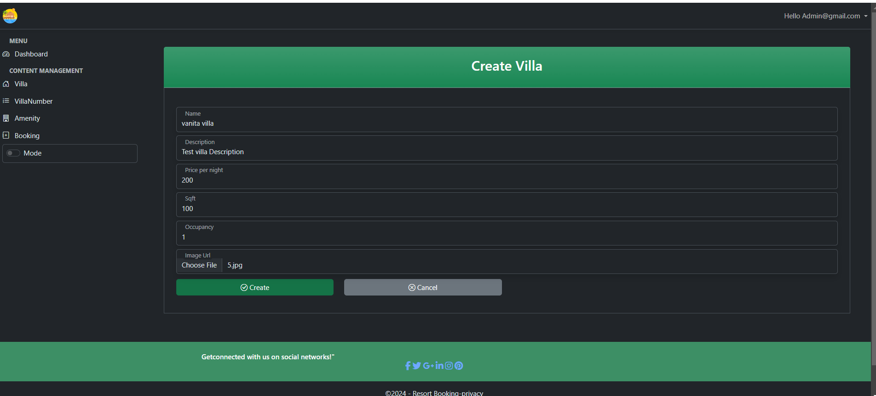
Create New Villa

Slide 41
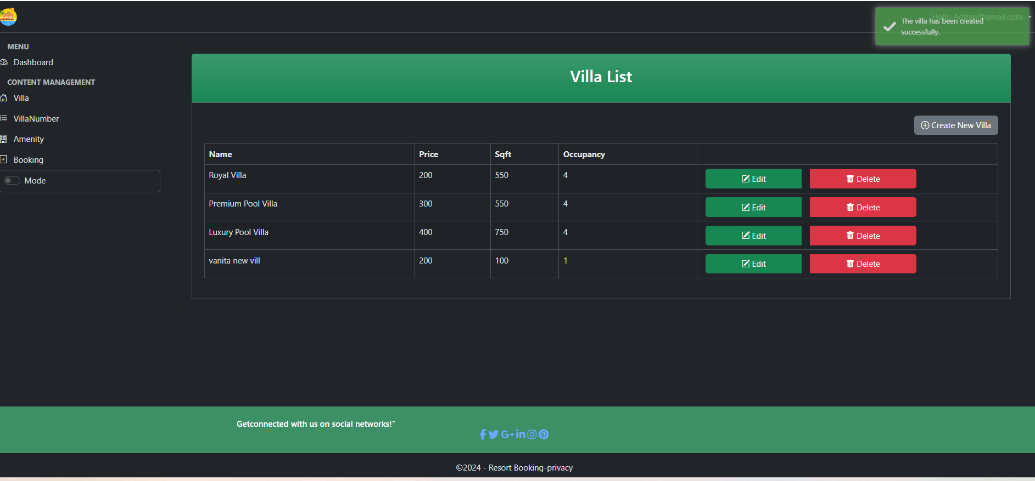
Created New Villa

Slide 42
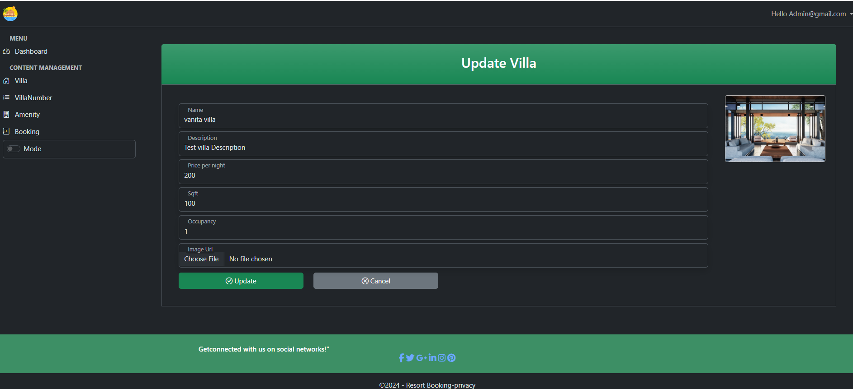
Update Villa

Slide 43
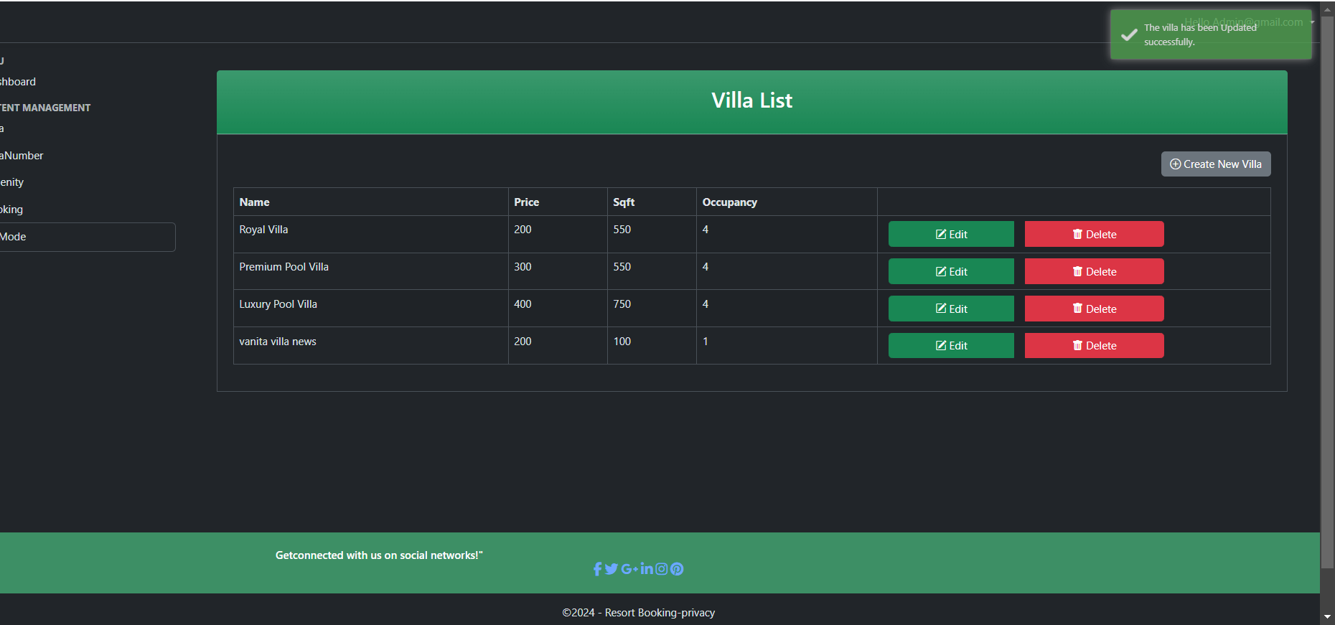
Update Villa

Slide 44
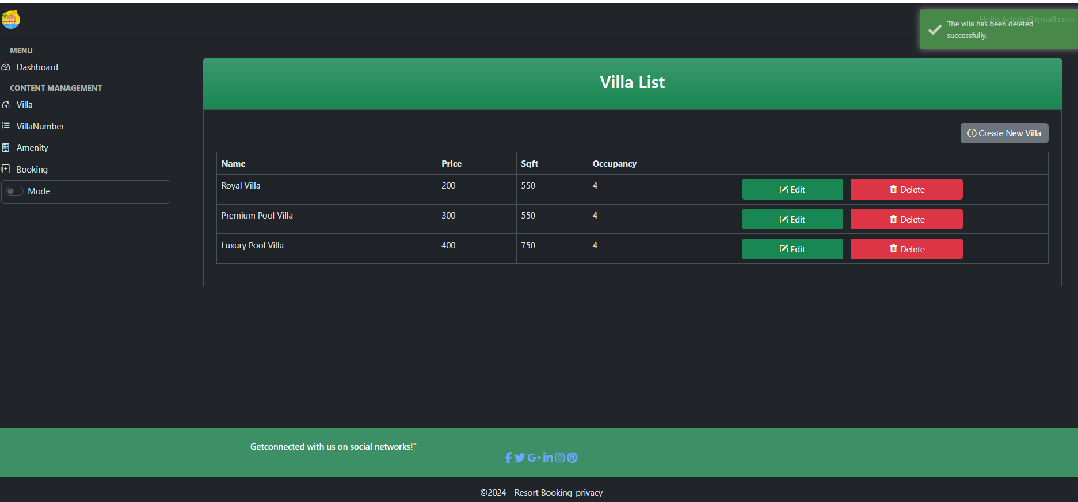
Delete Villa

Slide 45
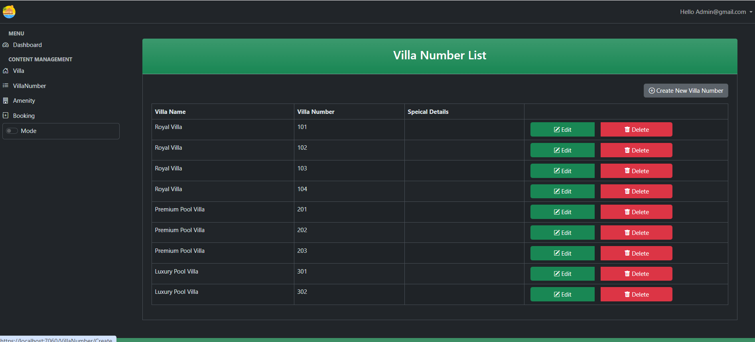
Created New Villa Number

Slide 46
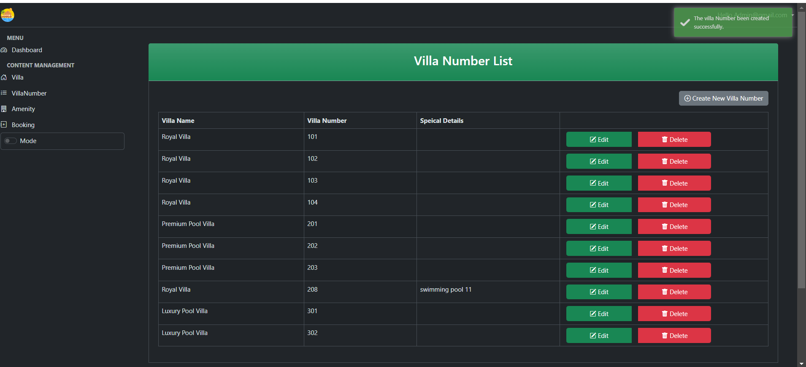
Created new Villa Number

Slide 47
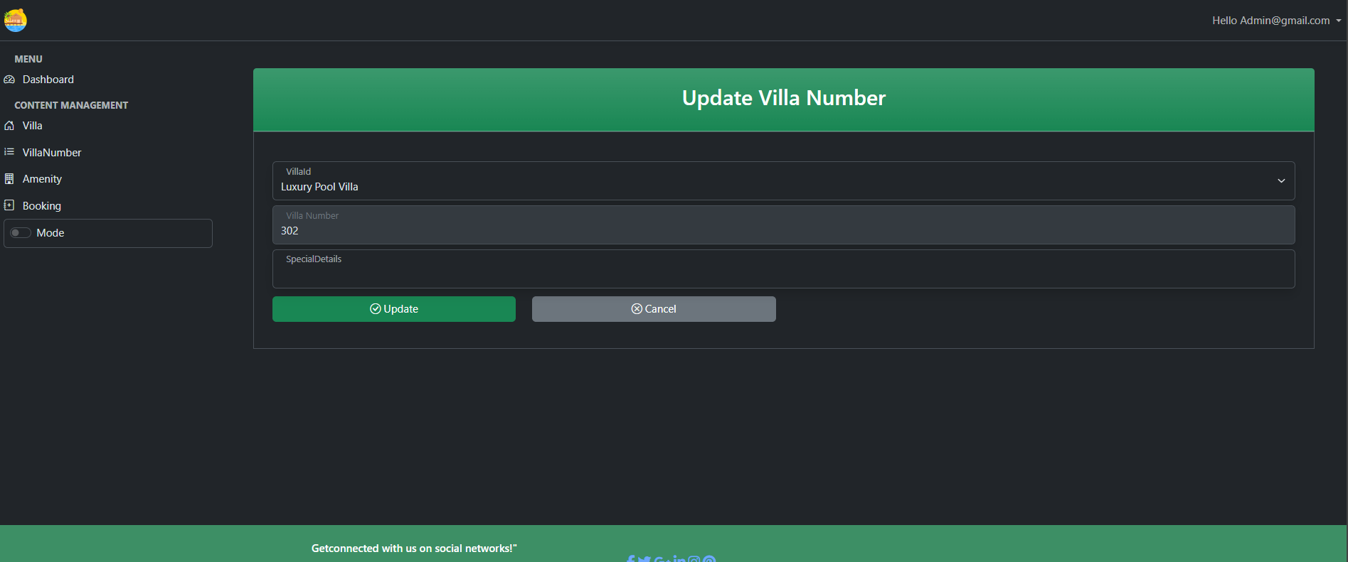
Update Villa Number

Slide 48
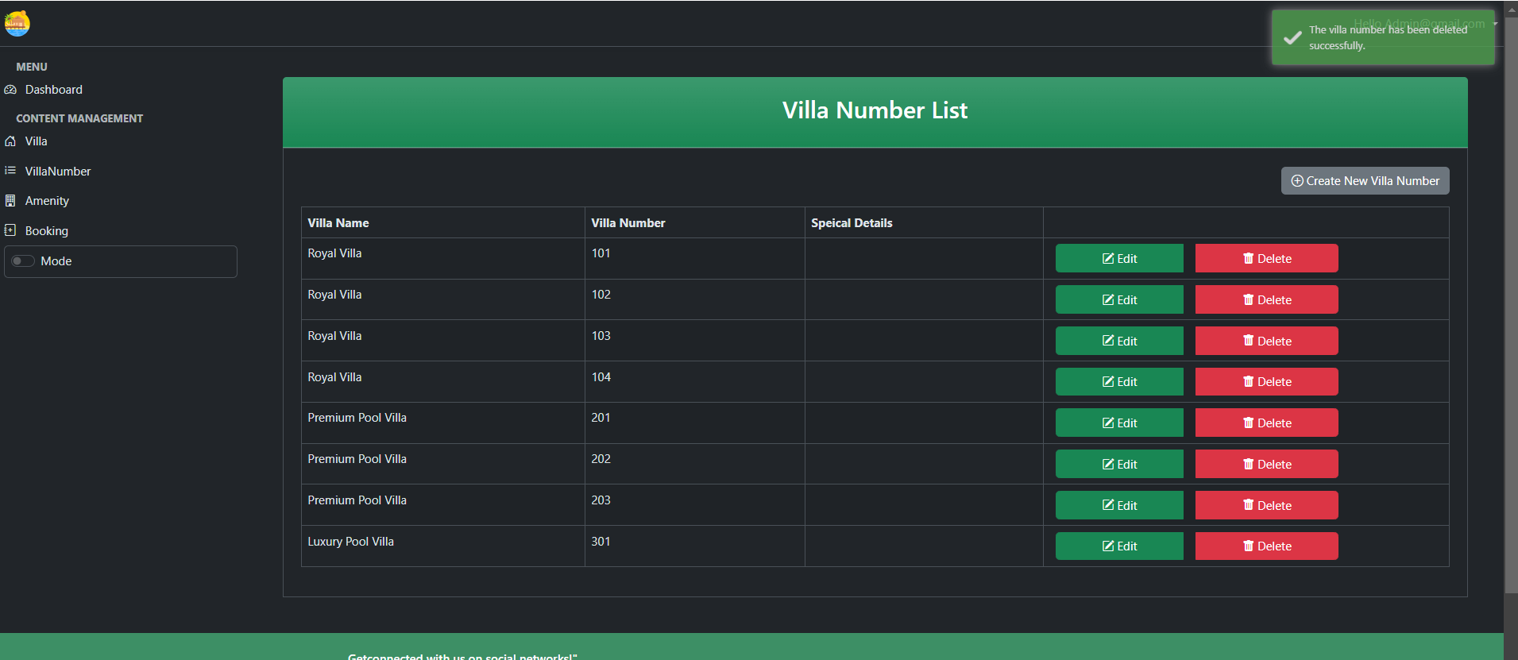
Delete Villa Number

Slide 49
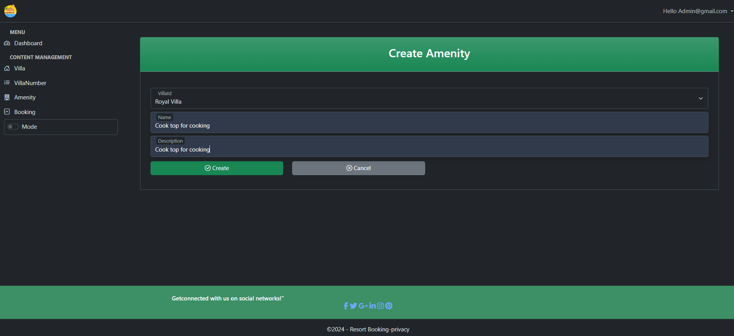
Create Amenity

Slide 50
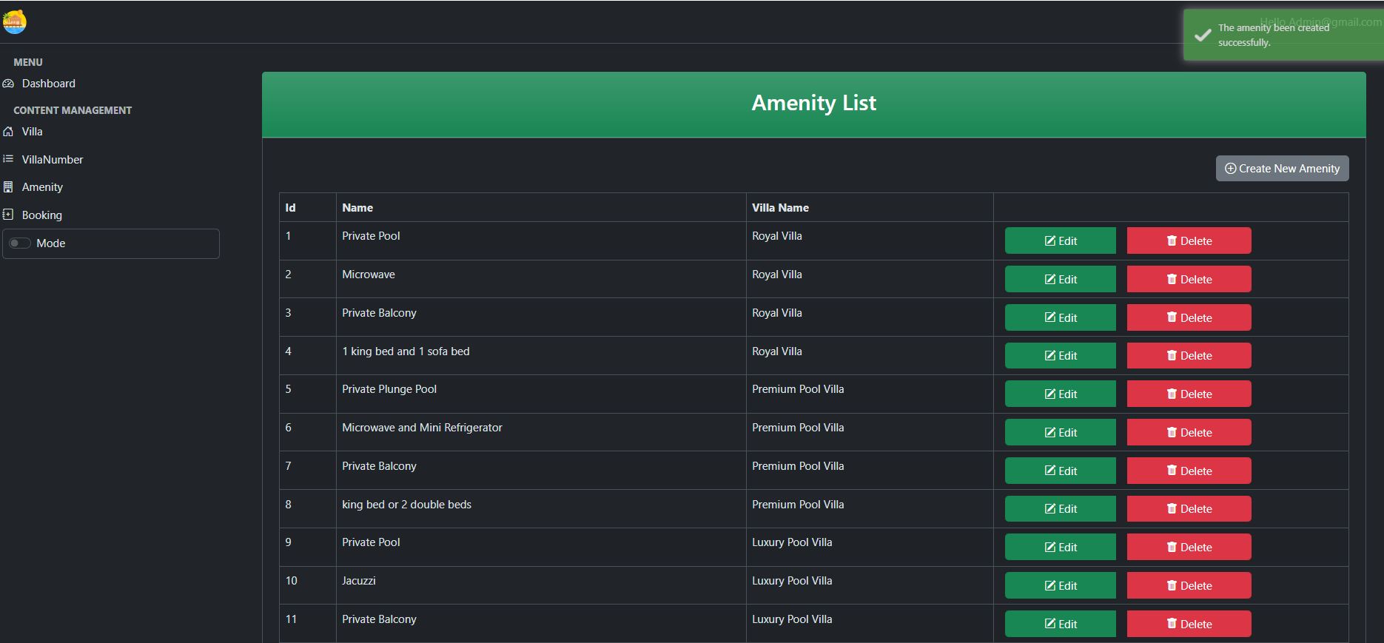
Create Amenity List

Slide 51
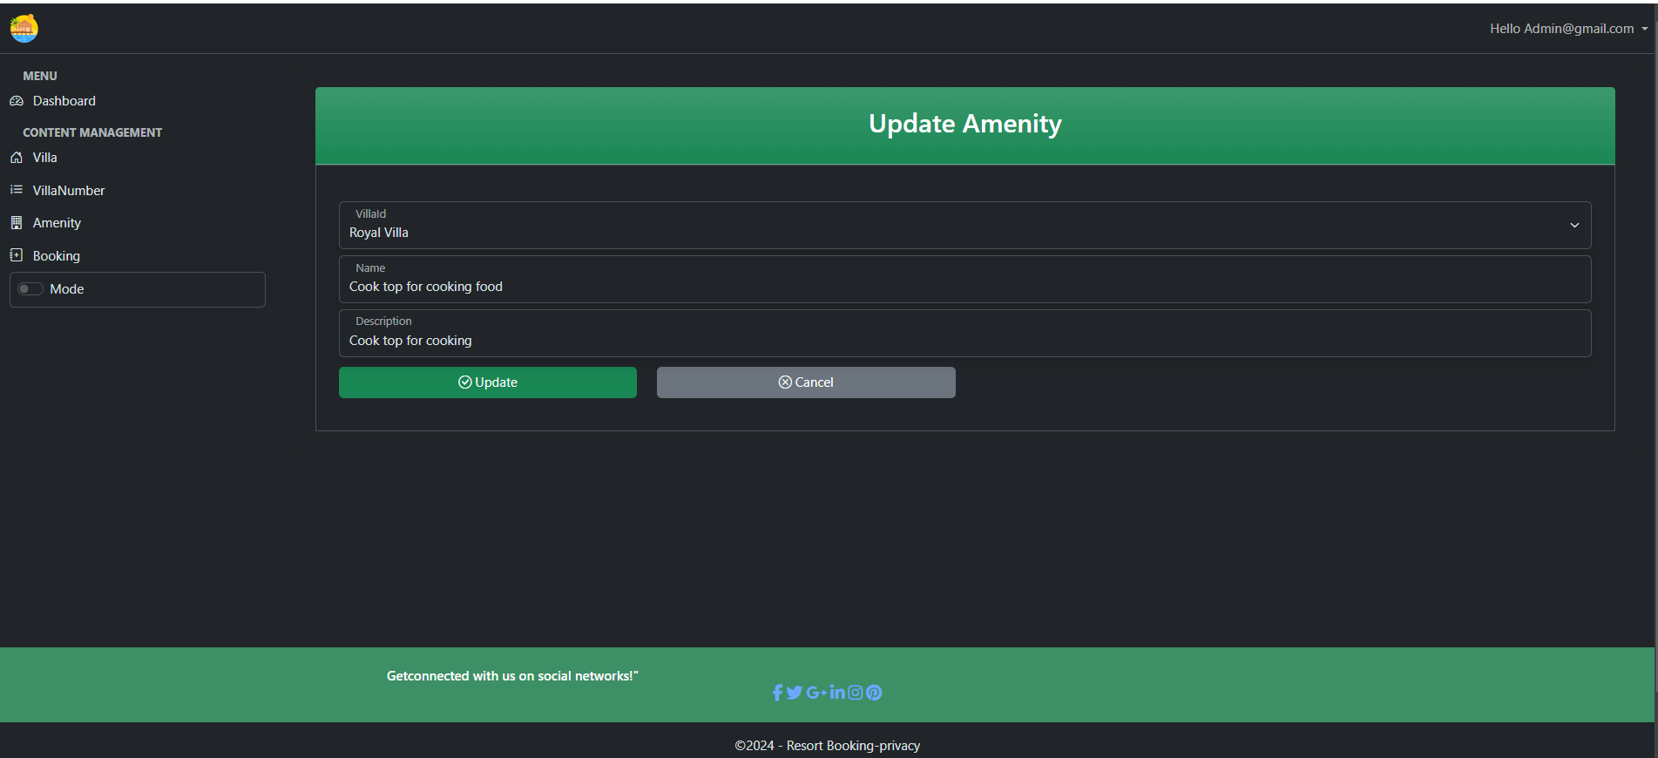
Update Amenity

Slide 52
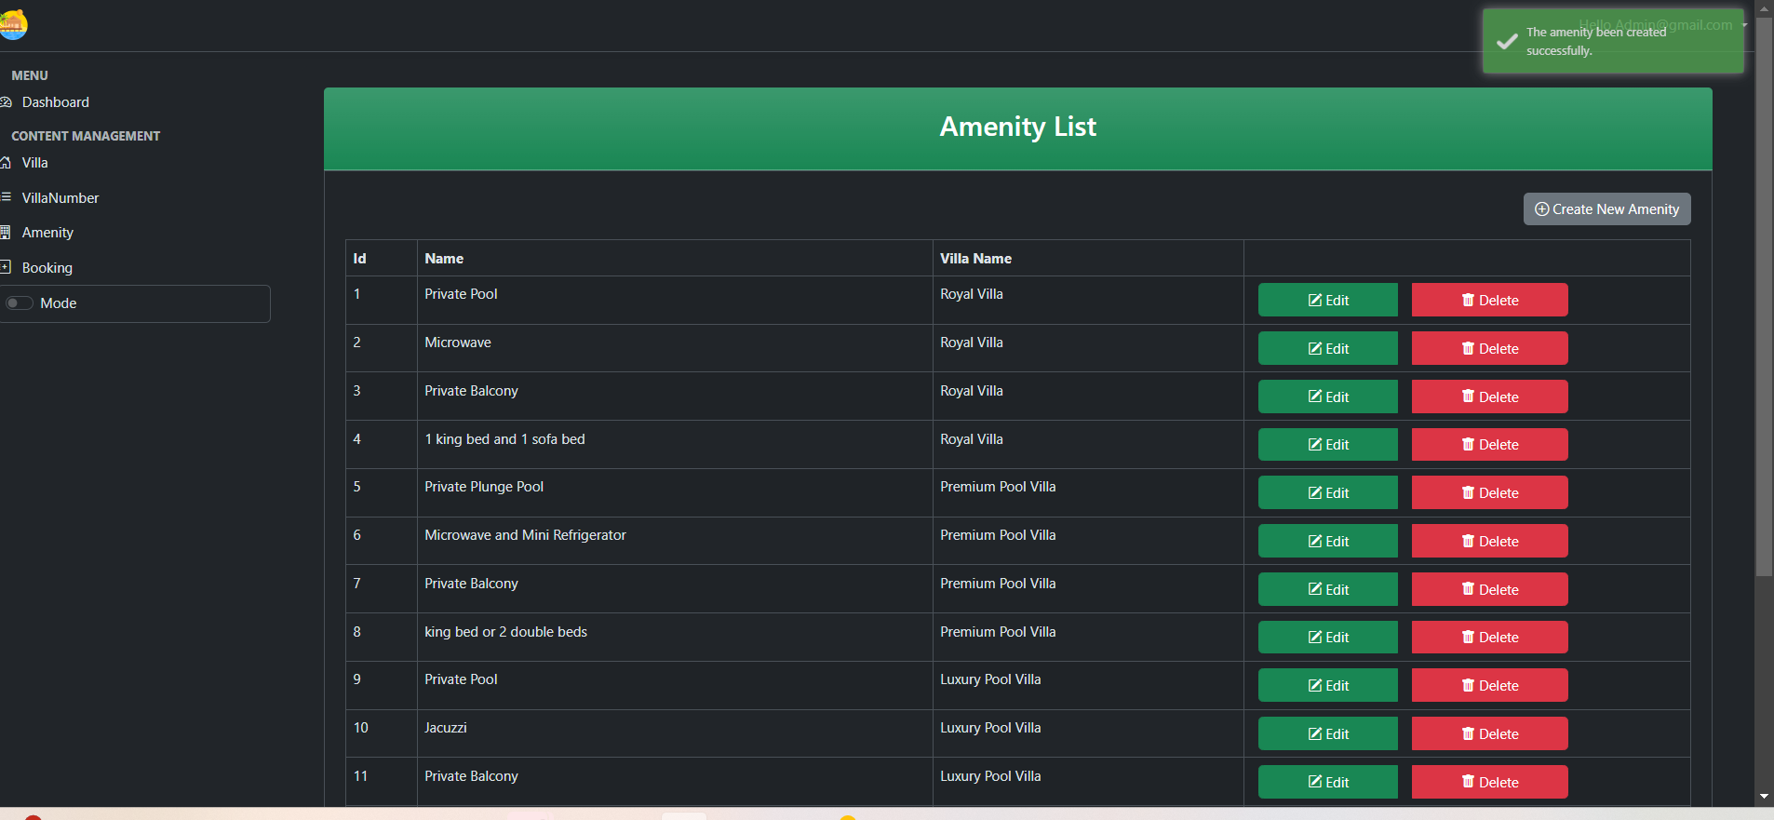
Update Amenity

Slide 53
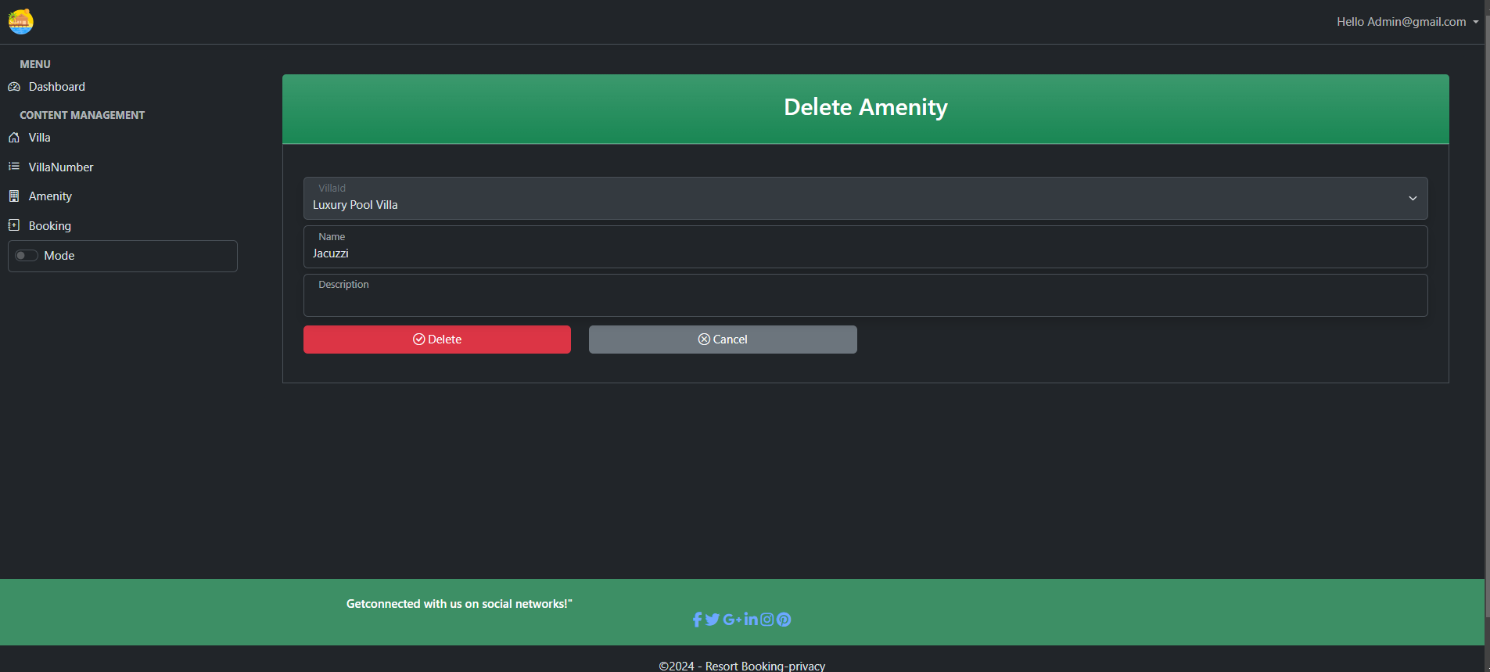
Delete Amenity

Slide 54
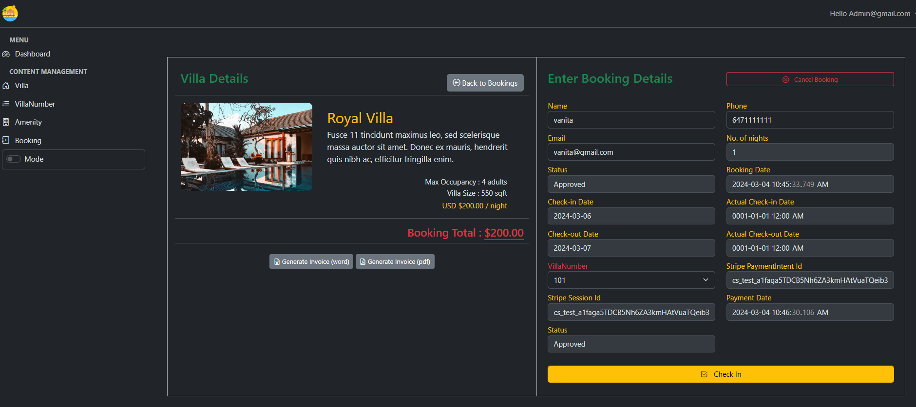
Booking Details

Slide 55
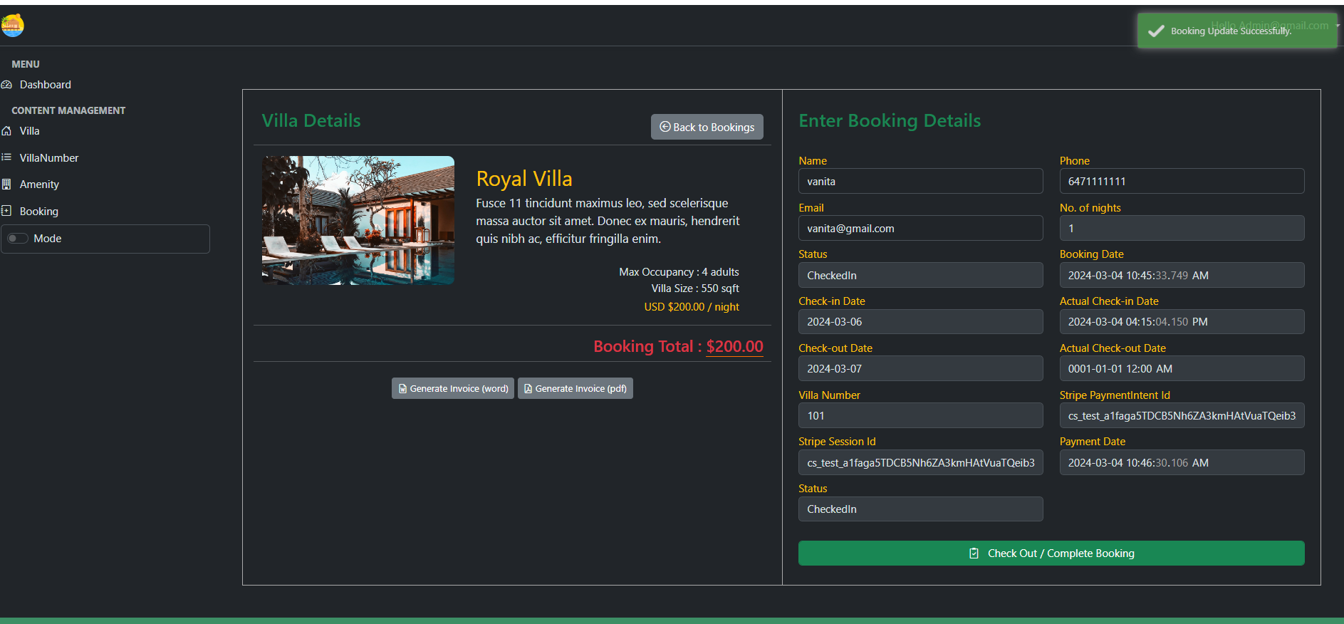
Admin Complete Booking

Slide 56
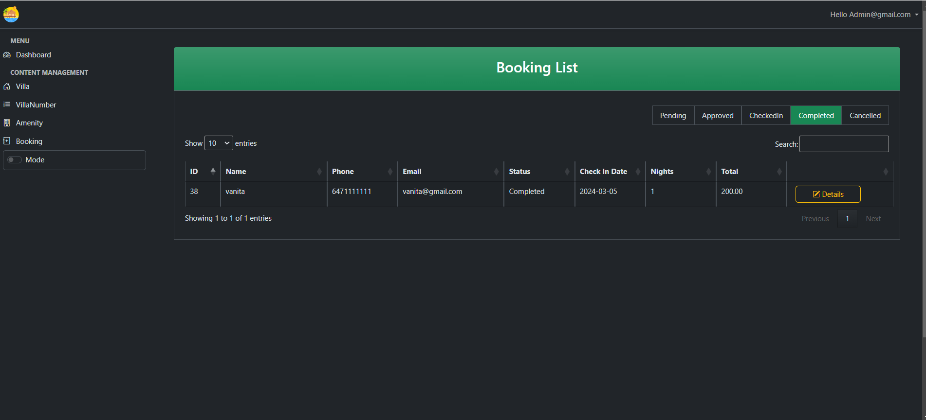

Complete Booking

Slide 57
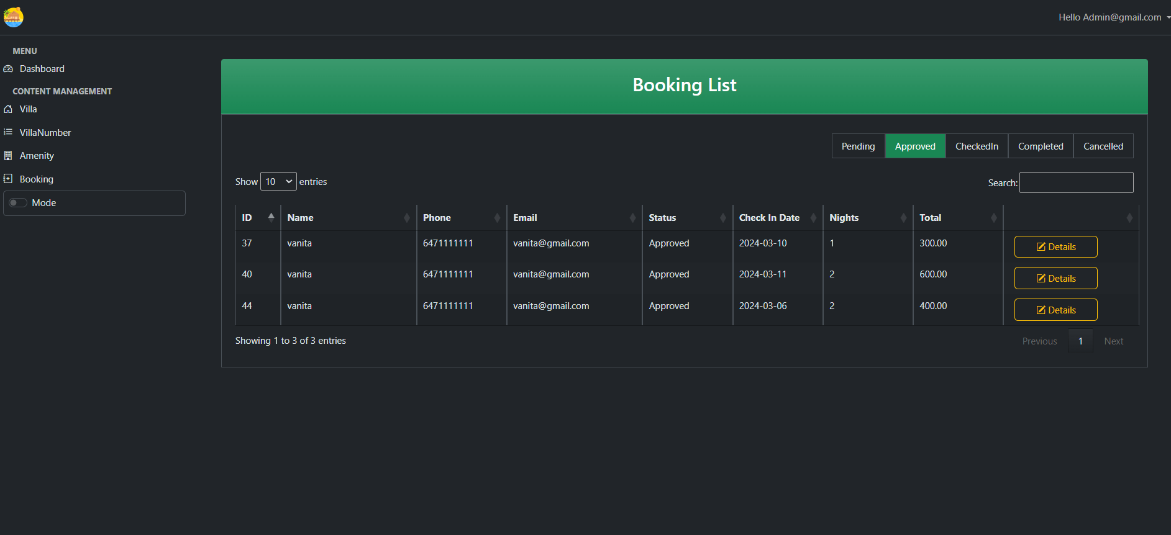
Admin View Booking Details

Slide 58
Admin Manage Booking Details

Slide 59
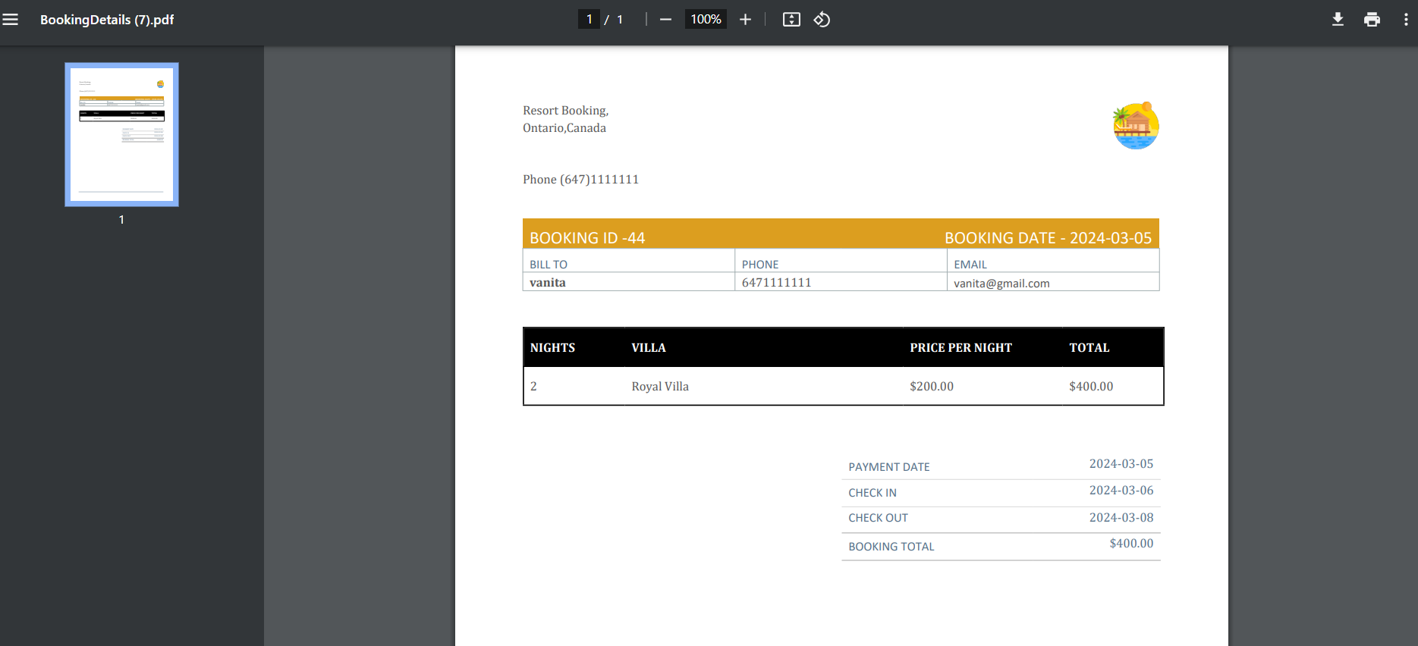
Admin Generate Invoice (Word,pdf)

Slide 60
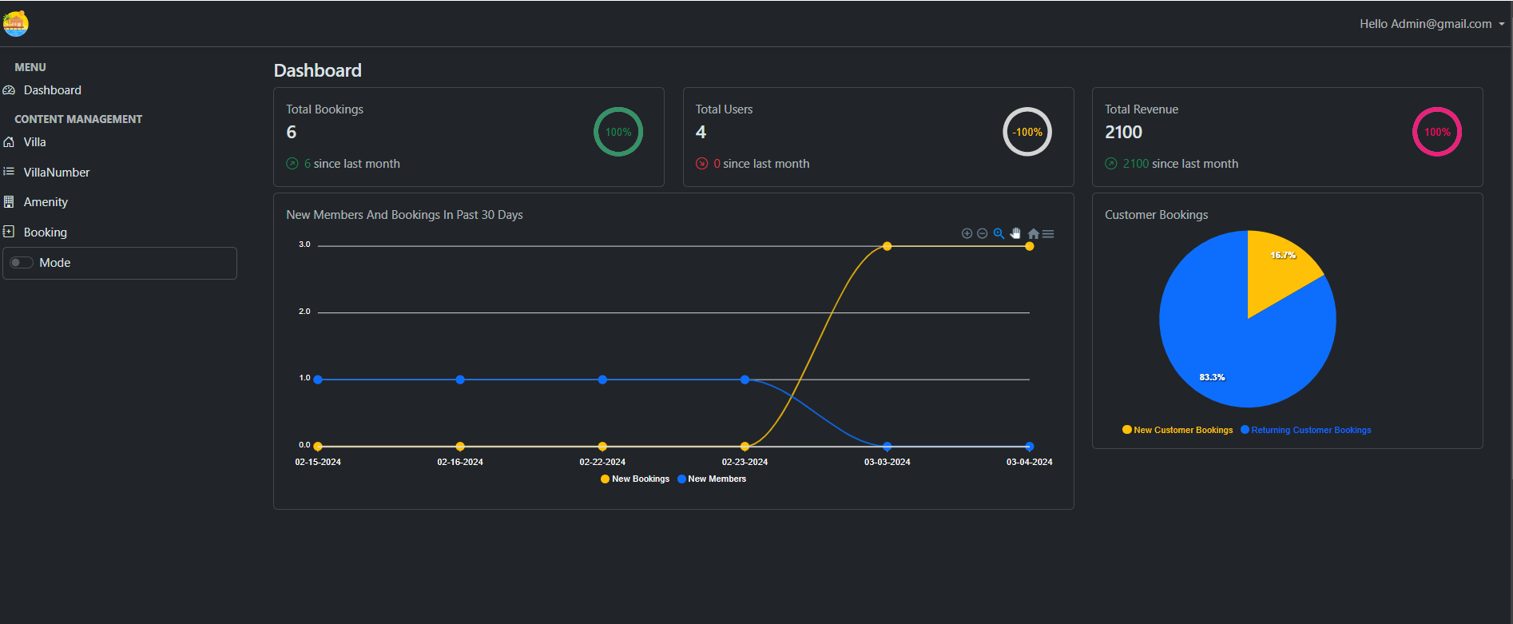
Dark Mode

Slide 61
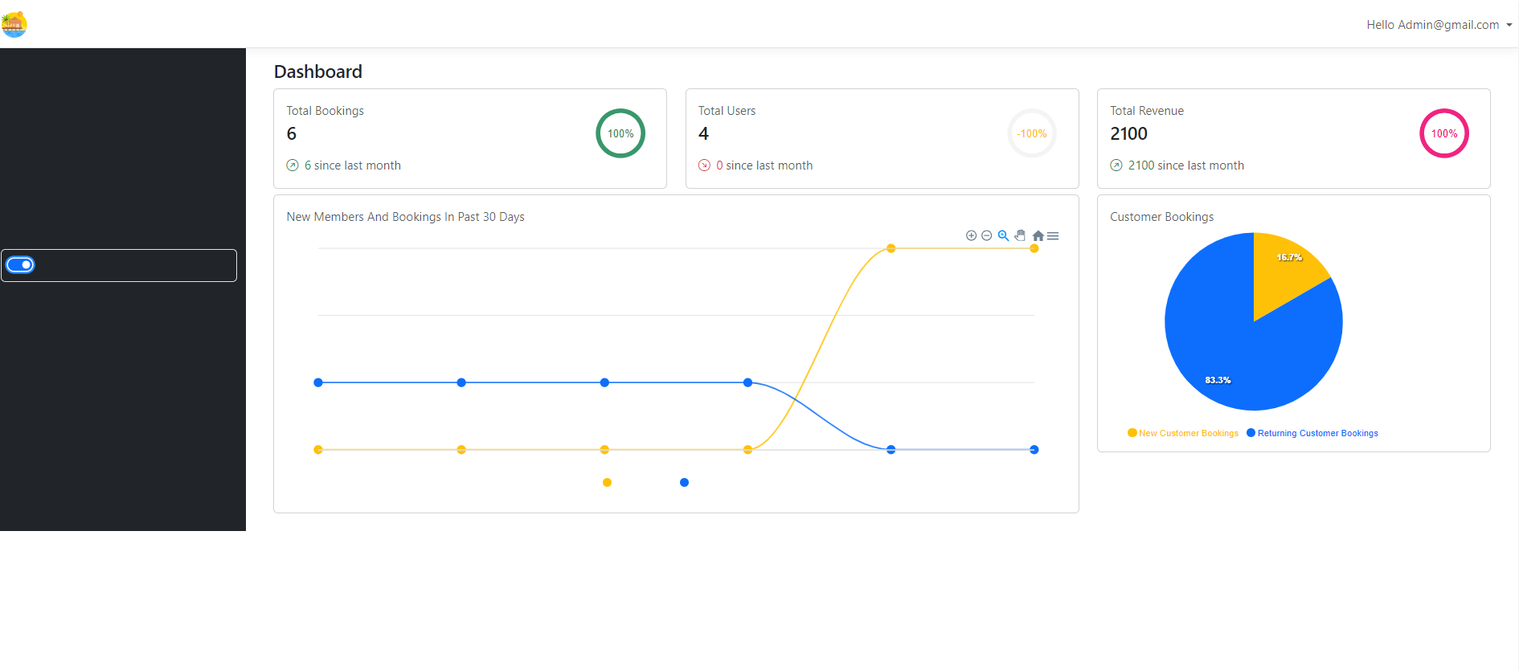
Light Mode

Slide 62
GitHub-Link
https://github.com/vanitaperu/WhiteLagoonResort

